Slide 1


Design of Remote Health Monitoring System
Aditya Sharma
118EI0714@nitrkl.ac.in
Electronics and Instrumentation
Under the supervision of Prof. Sudip Kundu

Slide 2
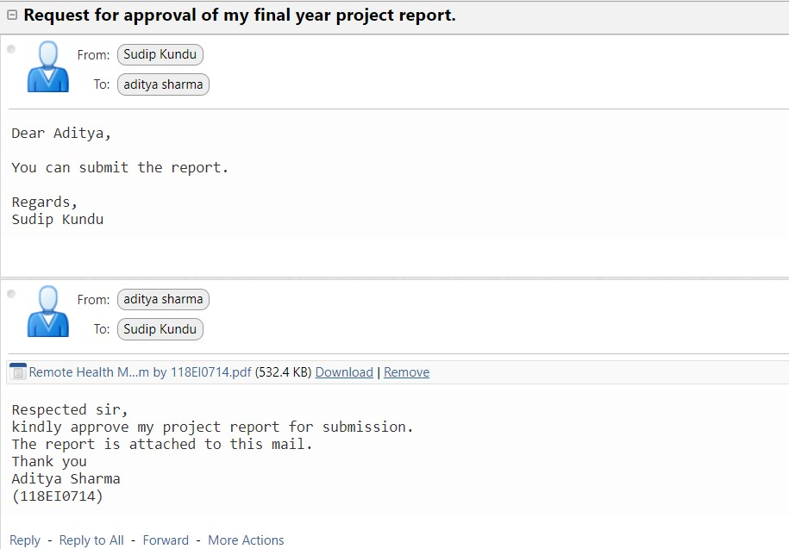
a snapshot of the approval

Slide 3
AIM
This project aims to develop a remote health monitoring platform using IoT to help in proper remote diagnosis of patients by doctors by using an affordable, easy-to-use device that could be operated by oneself or under medical supervision as deemed fit.

Slide 4
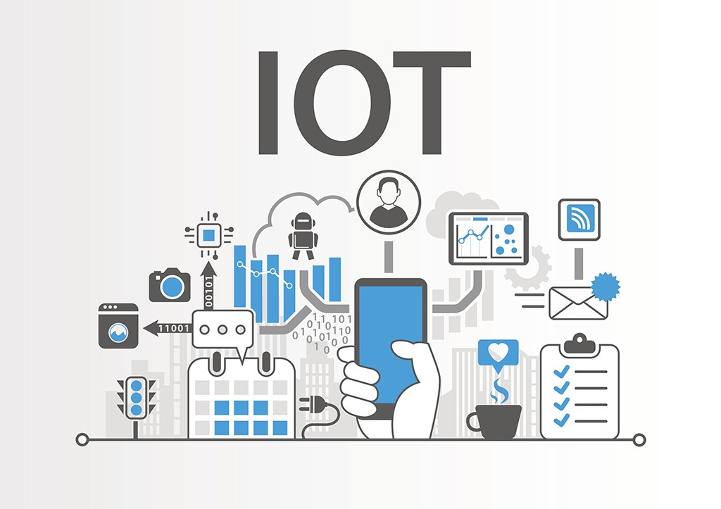
I. Introduction
Internet of Things and its developing multidisciplinary applications have altered the way of life.
“Smart Healthcare is one such trending IoT application, which connects smart devices, sensors, machinery, patients, doctors to the internet”.
This new healthcare trend has enabled doctors to do remote monitoring, chronic illness management, and senior care of remote patients, as well as caring after institutionalized patients, in an effective and intelligent manner.

Slide 5
II. Motivation
Looking into the current society, especially in the rural establishments of India, the medical facilities are very poor.
Sometimes, it is tough to even reach a hospital on time due to a lack of transportation facilities in the region.
Due to these difficulties, millions of people have suffered during the current COVID-19 pandemic.
The motivation behind this project is to propose a smart healthcare solution for these situations when proper medical facilities are not easily available.
Also using a remote health monitoring system will decrease health-care expenditures by lowering doctor visits, hospitalizations, and diagnostic testing procedures.

Slide 6
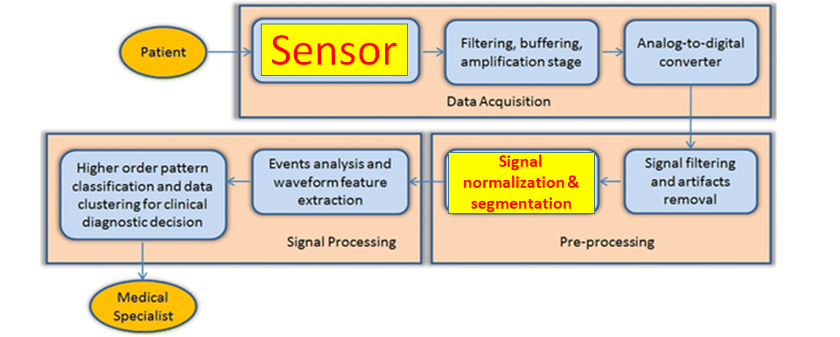
III. Methodology
The proposed Instrumentation system for biomedical device mainly consists of three modules:
Signal Acquisition
Signal Processing
Signal Transmission
Fig: Block diagram

Slide 7
IV. Electrocardiography
The Electrocardiogram is a surface measurement of the electrical potential generated by electrical activity in cardiac tissue. Current flow (in the form of ions) indicates the contraction of cardiac muscle fibers leading to the heart’s pumping action.
The bandwidth of an ECG signal with a 12 lead historically has been 0.05 - 150 Hz, but with recent standards and the specific patient population being viewed, the values may range. The peak amplitude of the signal ranges from 0.01 mV to 5 mV.

Slide 8
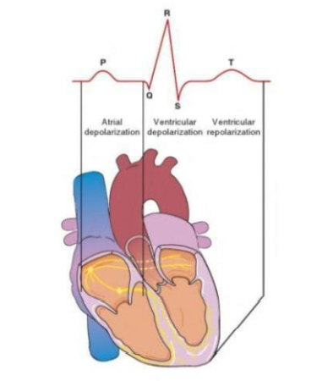
How is ECG generated?
Electrical signals are produced by contractions in the heart walls which drive electrical currents and create different potentials throughout the body. By placing electrodes on the skin, one can detect and record this electrical activity in an ECG.
Fig: How a heartbeat is represented as a signal

Slide 9
ECG Electrodes
Each electrode consists of an electrically conductive electrolyte gel and a silver/silver chloride conductor. The gel typically contains potassium chloride – sometimes silver chloride as well – to permit electron conduction from the skin to the wire and to the electrocardiogram. The electrode gel reduces the electrical impedance at the point of contact with the skin so that this impedance is as small as possible to avoid attenuation of the signal.

Slide 10
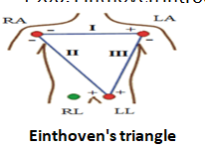

Placement of Electrodes
Einthoven's triangle is an imaginary formation of three limb leads in a triangle used in electrocardiography, formed by the two shoulders and the pubis. The shape forms an inverted equilateral triangle with the heart at the center.
Each lead measures the electric field created by the heart during the depolarization and repolarization of myocytes.
Lead: Any pair of electrodes can measure the electrical potential difference between the two corresponding locations of attachment. Such a pair forms a lead.
Limb Leads:
Lead 1: LA-RA
Lead II: LL-RA
Lead III: LL-LA
Common virtual electrode, known as the Wilson's central terminal (V_{W}) =
Fig: Einthoven’s Triangle of the Bipolar Limb Leads

Slide 11
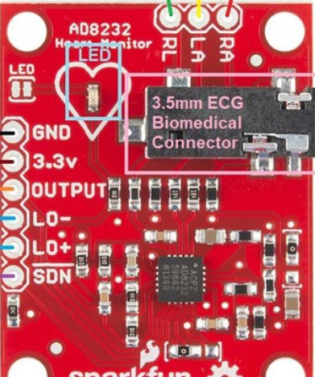
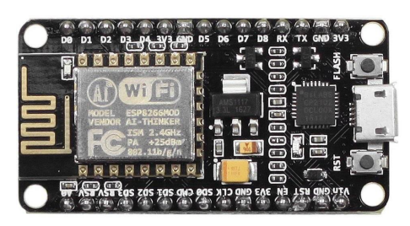
Hardware Used
NodeMCU (ESP8266-12E Board)
ECG Sensor (AD8232 ECG Sensor Kit)
Data Cables (5V micro USB)
Breadboard and Jumper wires
Fig: ESP8266 module
Fig: AD8232 sensor

Slide 12
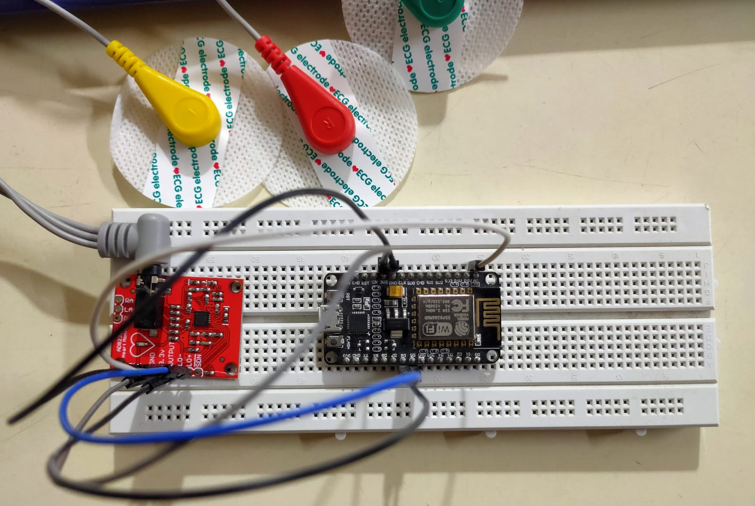
Circuit Connections
Output of AD8232 was connected to Analog pin A0 of NodeMCU.
L0+ and L0- to D5 and D6 of NodeMCU respectively.
VCC of AD8232 was connected to 3.3V and GND to GND.
Fig: circuit connections

Slide 13
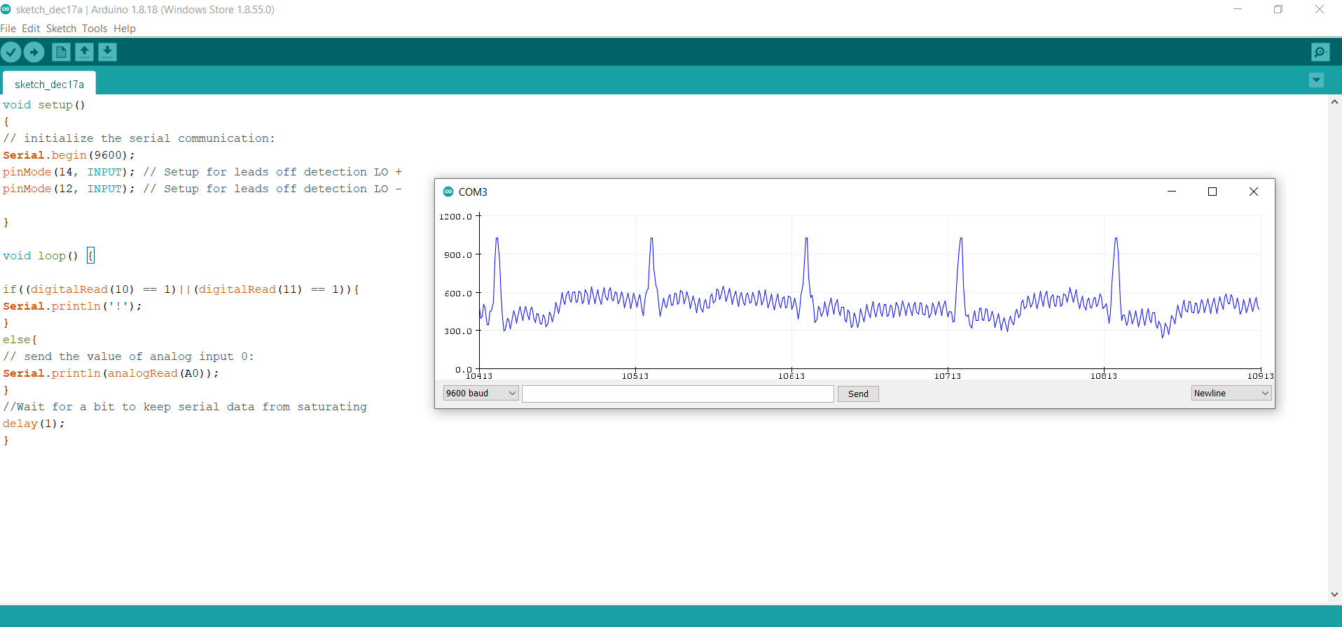
Output Waveform
I got the sensor on 17th december, and the output I was able to generate in 1 day is shown below. Better placement of the electrodes, using some electrode gel could result in better output.
Some tuning is required and due to unavailability of Oscilloscope I was not able to examine the output of the sensor.

Slide 14
V. Signal Transmission
For realtime visualization of the ECG waveform, and accessing it remotely, a cloud server is required to store the data.
We have used “Thingspeak” (by MATHWORKS) as a cloud server because it’s services are free of cost upto some limit, provides real-time data visualization by providing support for MATLAB language using which we can generate various plots on the data stream, and it is secure as well.
We have used Arduino IDE for programming the NodeMCU and used various libraries to establish a connection to the Thingspeak server. NodeMCU was connected to a wifi network using “<ESP8266WiFi.h>” and interfacing with the cloud server was done by including “<ThingSpeak.h>” library.
ESP8266 mainly uses MQ Telemetry Transport (MQTT) Protocol to communicate to the server.

Slide 15
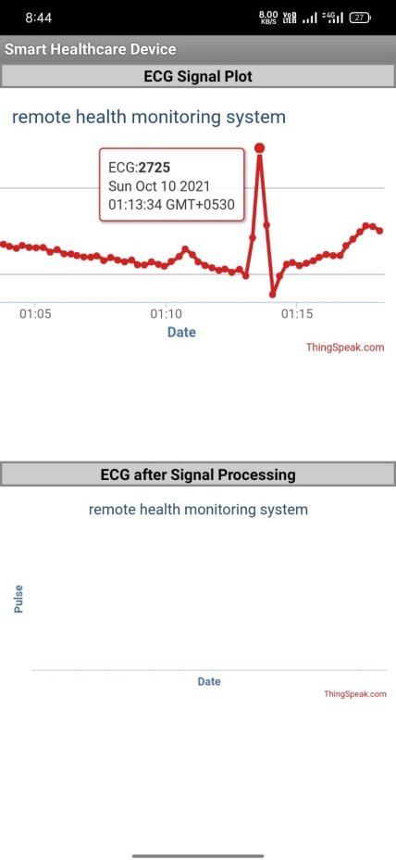
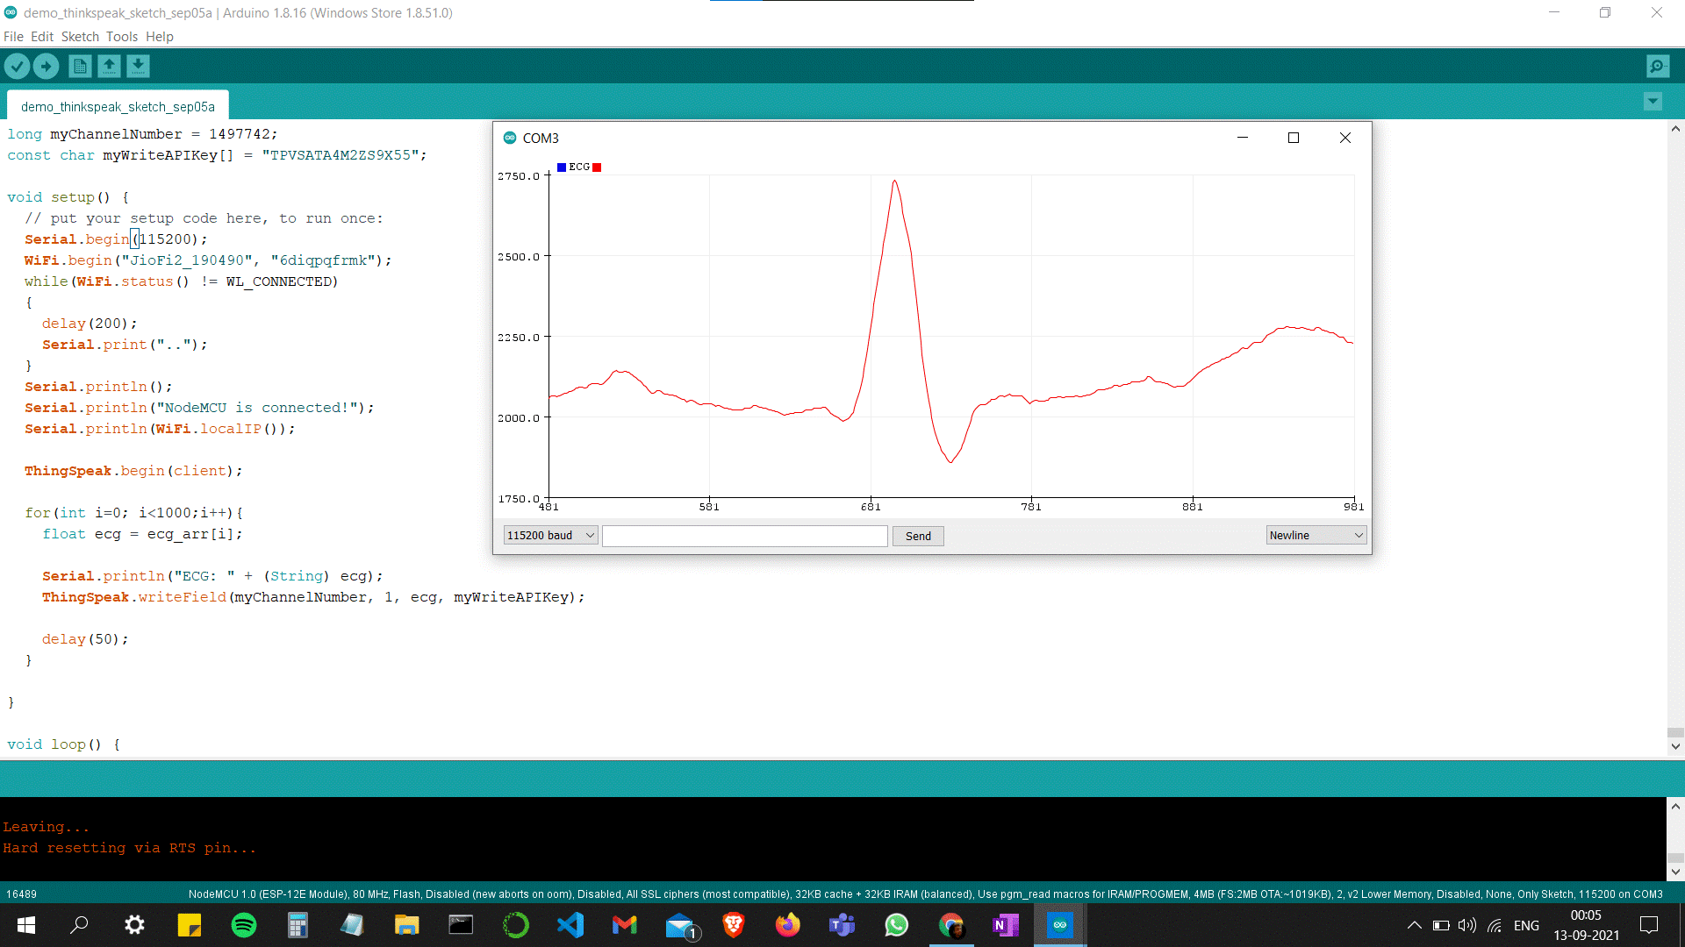
During completion of the data transmission part, I was not having the ECG sensor so I have used a ecg dataset from internet, and created a array of those floating type data values (32 bit size for 1 input value) and provided it as a input to the nodeMCU and tried to send this data to thingspeak server using Arduino IDE and generating the wavform on the android application. Results obtained are shown below:
Fig: sending the real-time data to a cloud server
Fig: screenshot of the waveform generated on the android app

Slide 16
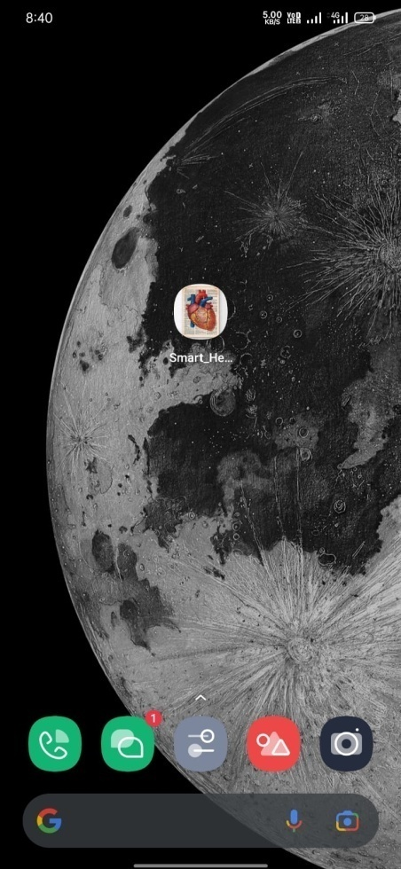
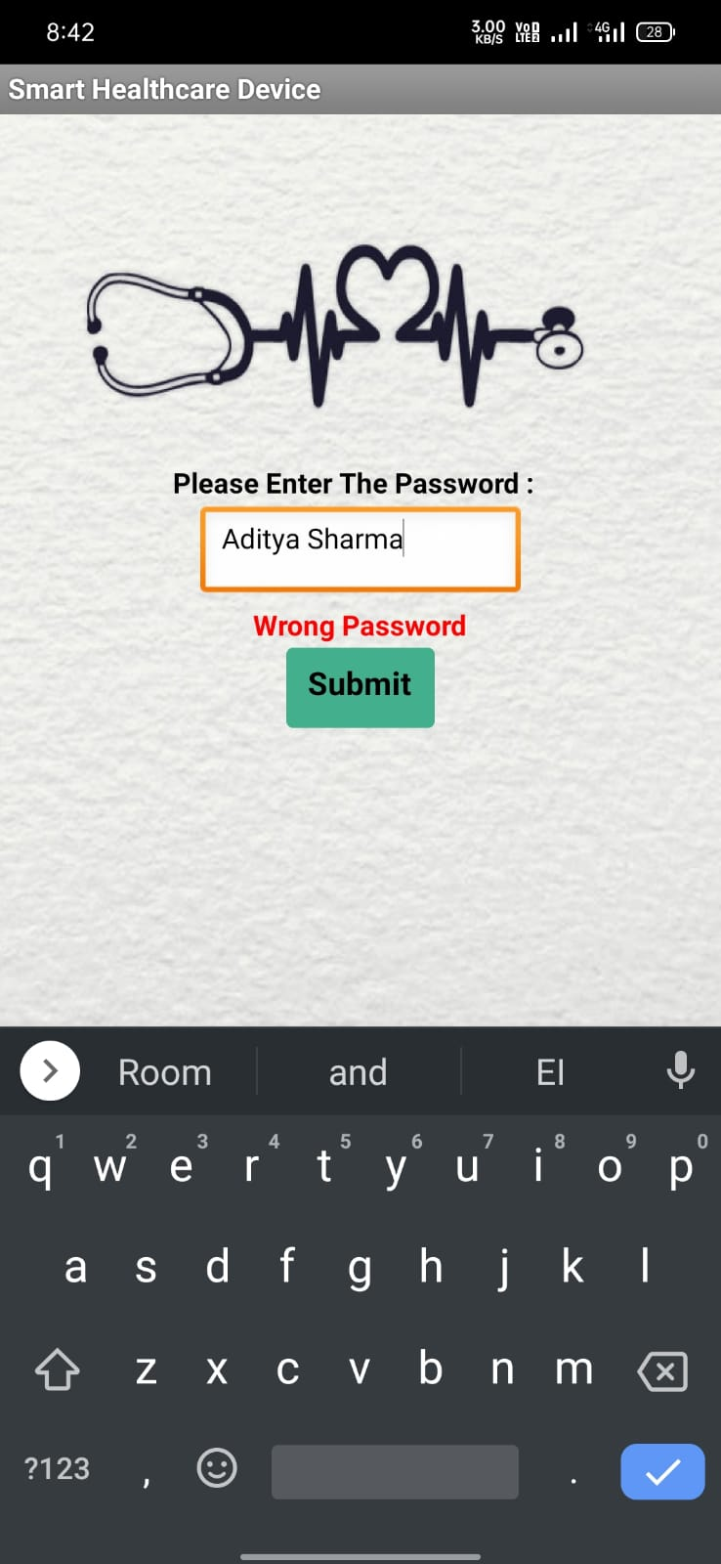
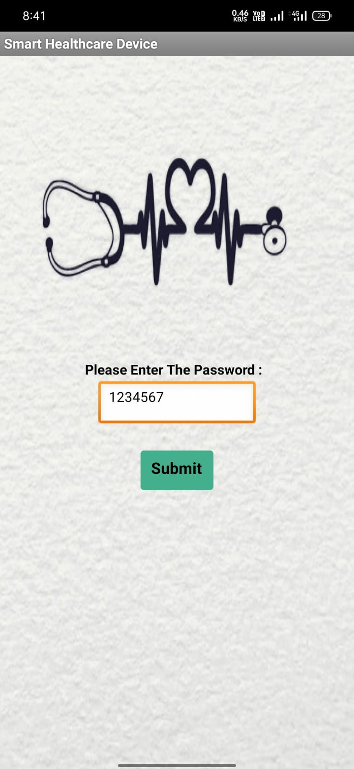
VI. User Interface Part: Android Application

Slide 17
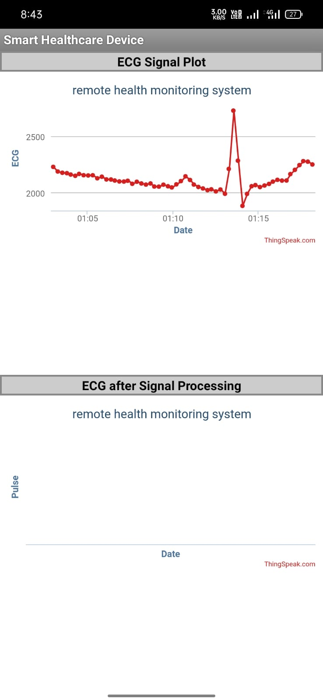

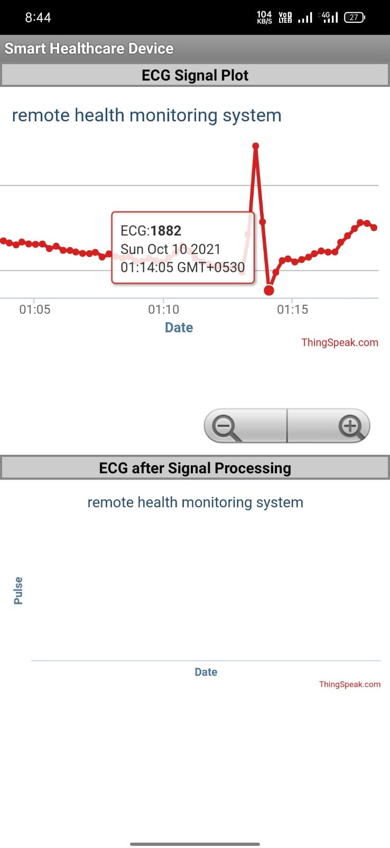
Link to download the application: here

Slide 18
VII. Future Plans
Analyzing the sensor output ECG waveform using instruments like cathode-ray oscilloscope (CRO) at NIT Labs.
Generate more accurate results by better placement of electrodes and using some better electrolyte gel and a silver/silver chloride conductor.
Do some signal processing on the output and do the real time transmission of the generated ECG signal to the developed android application.
Detecting R-peaks and measuring a person's heart rate using some signal processing.
A supervised machine learning model can be trained using some datasets available, so that we can detect anomalies in the ecg signal and give alerts at the android application so that heart disease can be detected in the early state.

Slide 19
VIII. Conclusion
Smart monitoring systems help in detecting symptoms quickly and treating them on time. This is great for both physicians and patients as the stress is reduced immensely. Moreover, patients can receive personalized treatments with the help of IoT-enabled devices as doctors can get a clear picture of their lifestyle and case history.

Slide 20
IX. References
Raffaele Galiero, Pia Clara Pafundi, Riccardo Nevola, Luca Rinaldi, Carlo Acierno, Alfredo Caturano, Teresa Salvatore, Luigi Elio Adinolfi, Ciro Costagliola, Ferdinando Carlo Sasso, "The Importance of Telemedicine during COVID-19 Pandemic: A Focus on Diabetic Retinopathy", Journal of Diabetes Research, vol. 2020, Article ID 9036847, 8 pages, 2020. https://doi.org/10.1155/2020/9036847
Khadijah Ibrahim, Athina Katsoula, Alexandra Meraz, Nghia Nguyen Trong, Design of Electromyogram and Electrocardiogram Acquisition Systems (2021)
Kumar, A. (2020, January 08). 10 Lead ECG Placement [Digital image]. Retrieved March 28, 2021.
Prajoona Valsalan1, Tariq Ahmed Barham Baomar, Ali Hussain Omar Baabood, IOT BASED HEALTH MONITORING SYSTEM, Journal of Critical Reviews, Vol 7, Issue 4, 2020, from: http://www.jcreview.com/admin/Uploads/Files/61a9c16c5cd5c6.82533458.pdf
Thakor, N. V., & Webster, J. G. (1980). Ground-free ECG recording with two electrodes. IEEE Transactions on Biomedical Engineering, (12), 699-704.
Hampton, J. R., & Hampton, J. (May, 2019). Part 1: The ECG made very easy indeed. In The ECG made easy (9th ed., pp. 1-7). Amsterdam: Elsevier.
Francis, J. (2016). ECG monitoring leads and special leads. Indian pacing and electrophysiology journal, 16(3), 92-95.
Cheena Sharma and Dr. Sunanda, International Journal on Emerging Technologies (2017)
https://www.researchtrend.net/
Company-Bosch, E., & Hartmann, E. (2003, November). ECG Front-End Design is Simplified with MicroConverter®. Retrieved October 05, 2020

Slide 21
Thank You

Slide 22
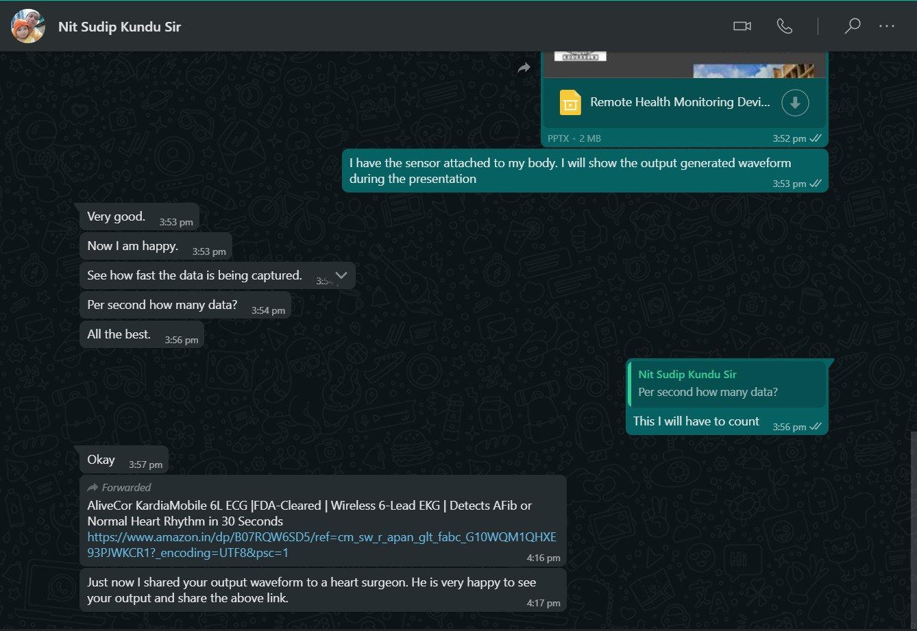

Slide 23
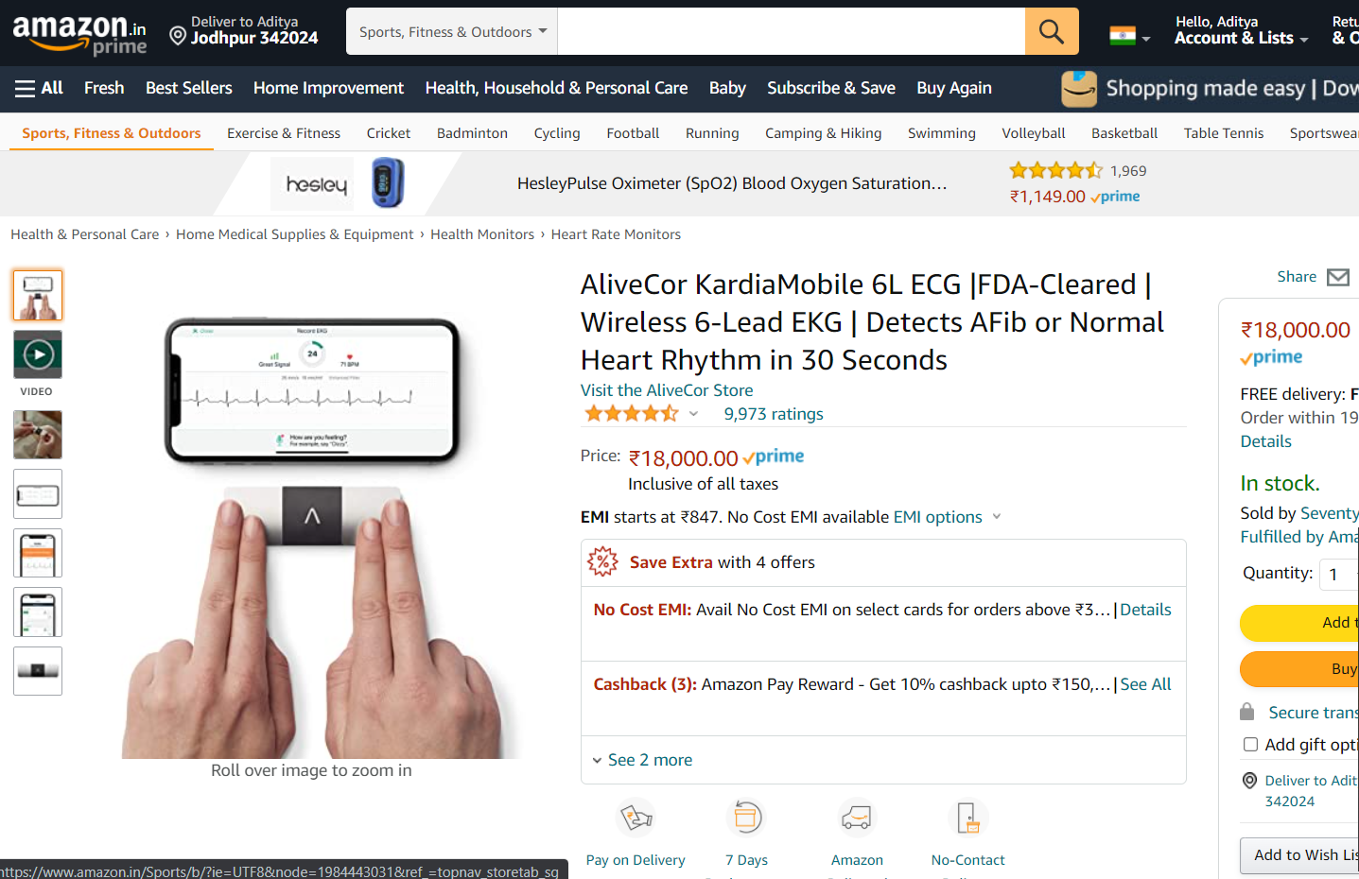

Slide 24
